Slide 1
a
¬a
a → (b ∧ ¬c)
b
¬b
¬(a → (b ∧ ¬c))
b ∧ ¬c
¬(b ∧ ¬c)
¬c
¬¬c

Slide 2
a
a → (b ∧ ¬c)
¬a
b
¬b
¬(a → (b ∧ ¬c))
b ∧ ¬c
¬(b ∧ ¬c)
¬c
¬¬c
¬a
ε
¬_{E}
⊥
¬_{E}
ε
¬(a→a)
ε
¬a
¬(a →a)
ε
⊥
→_{I}
⊥
a
a
a→a
→_{E}
ε
ε
⊥
a→b
a
¬(a→b)
⊥
a→b
a
b
b
a→b
¬(a→b)
a→b
⊥ rule
¬E rule
→I rule
→E rule

Slide 3
ε
a→b
ε
a
¬(a→b)
a
a→b
⊥
⊥
a→b
→_{I}
b
b
→_{E}
⊥
¬_{E}
¬(a→b)
ε
a→b
ε
ε
a→a
ε
a
¬(a→a)
a
a→a
⊥
⊥
a→a
→_{I}
a
b
→_{E}
⊥
¬_{E}
¬(a→a)
ε
a→b
ε
{b, ¬(a→b)}
⊥
b
{a, b}
⊥, ¬(a→b)
→I, a
a→b
{b}
{ , {b},{¬(a→b)}}
{ , {b},{¬(a→b)}}
{ , {b}, {a}}
⊥
⊥
b
⊥, ¬(a→b)
⊥, ¬(a→b)
→I, a
{ , {b}, ∅}
{ , {b}, ∅}
a→b
a→b

Slide 4
{a, {¬(a→a), a}}
{⊥,{¬(a→a), ¬a}
→I, a
⊥, ¬a
{a→a, ,{¬(a→a)}
{¬(a→a),{¬(a→a)}
{a,{¬(a→a)}
{¬a,{¬(a→a)}
¬E
¬E
{a, {a}}
{⊥,{¬(a→a)}}
→I, a
⊥, ¬(a→a)
{a→a, ∅}
. . .
{a, {¬(a→a), a}}
{⊥,{¬(a→a), ¬a}
→I, a
⊥, ¬a
{a→a, ,{¬(a→a)}
{¬(a→a),{¬(a→a)}
{a,{¬(a→a)}
C
¬E
{a, {a}}
{⊥,{¬(a→a)}}
→I, a
B
{a→a, ∅}
A

Slide 5


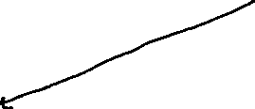

. . .
(Σ∪{a,¬a})⊢a
→I
(Σ ∪{¬a})⊢¬(a→a)
(Σ ∪{¬a})⊢a
(Σ ∪{¬a}) ⊢¬a
(Σ ∪{¬a})⊢a→a
(Σ ∪{¬a})⊢⊥
Σ⊢¬(a→a)
(Σ ∪{a})⊢a→a
(Σ ∪{a})⊢¬(a→a)
Σ⊢a
Σ⊢¬a
¬E
(Σ∪{a})⊢a
Σ⊢⊥
¬E
→I
⊥
(Σ ∪{a})⊢⊥
Σ⊢a→a

Slide 6



{a, {¬(a→a), a}}
{⊥,{¬(a→a), ¬a}
→I, a
⊥, ¬a
{a→a, ,{¬(a→a)}
{¬(a→a),{¬(a→a)}
{a,{¬(a→a)}
{¬a,{¬(a→a)}
¬E
¬E
{a, {a}}
{⊥,{¬(a→a)}}
→I, a
⊥, ¬(a→a)
{a→a, ∅}
{¬(a→a),a} ⊢a
→_{I}
{¬(a→a)} ⊢a→a
{¬(a→a)} ⊢¬(a→a)
{a} ⊢a
¬_{E}
→_{I}
{¬(a→a)}⊢ ⊥
⊢a→a
B
A

Slide 7
{¬(a→a)} ⊢a→a
{¬(a→a) ⊢a
{¬(a→a)} ⊢¬(a→a)
{¬(a→a)} ⊢¬(a→a)
¬_{E}
¬_{E}
{a} ⊢a
{¬(a→a)}⊢ ⊥
{a} ⊢a
{¬(a→a)}⊢ ⊥
→_{I}
⊥
→_{I}
⊥
⊢a→a
⊢a→a
{¬(a→a),a} ⊢a
{¬(a→a), ¬a} ⊢ ⊥
{¬(a→a),a} ⊢a
→_{I}
→_{E}
⊥
→_{I}
{¬(a→a)} ⊢a→a
{¬(a→a)} ⊢a
{¬(a→a)} ⊢a→a
{¬(a→a)} ⊢a
⊥
⊥
{¬(a→a)} ⊢¬(a→a)
{¬(a→a)} ⊢¬(a→a)
{¬(a→a)} ⊢¬(a→a)
{¬(a→a)} ⊢¬(a→a)
¬_{E}
¬_{E}
¬_{E}
¬_{E}
{a} ⊢a
{¬(a→a)}⊢ ⊥
{a} ⊢a
{¬(a→a)}⊢ ⊥
→_{I}
⊥
→_{I}
⊥
⊢a→a
⊢a→a

Slide 8
{¬(a→a),a} ⊢a
{¬(a→a), ¬a} ⊢ ⊥
→_{I}
→_{E}
⊥
{¬(a→a)} ⊢a→a
{¬(a→a)} ⊢a
{¬(a→a)} ⊢¬(a→a)
⊥
{¬(a→a)} ⊢¬a
¬_{E}
¬_{E}
{a} ⊢a
{¬(a→a)}⊢ ⊥
→_{I}
⊥
⊢a→a

Slide 9
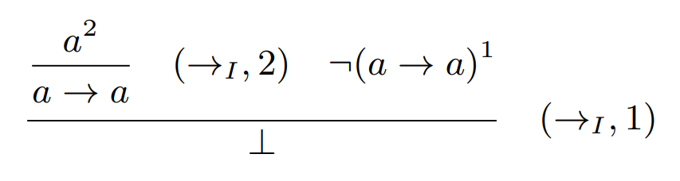

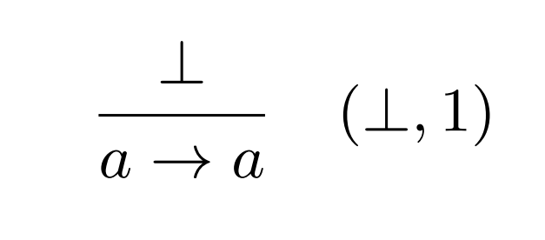


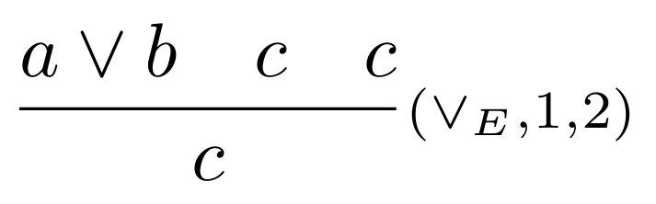

Possible solution
Incomplete proof
State: {⊥,{¬(a→a)}}
Rule application
Edge
Goal: {a ∨ b} ⊢a
ε
{a ∨ b} ⊢a ∨ b
Proved
1
2
∨_{E}
a
2,3
{a ∨ b} ⊢a
{a ∨ b ,a} ⊢a
Proved
b
{a ∨ b ,b} ⊢ a

Slide 10
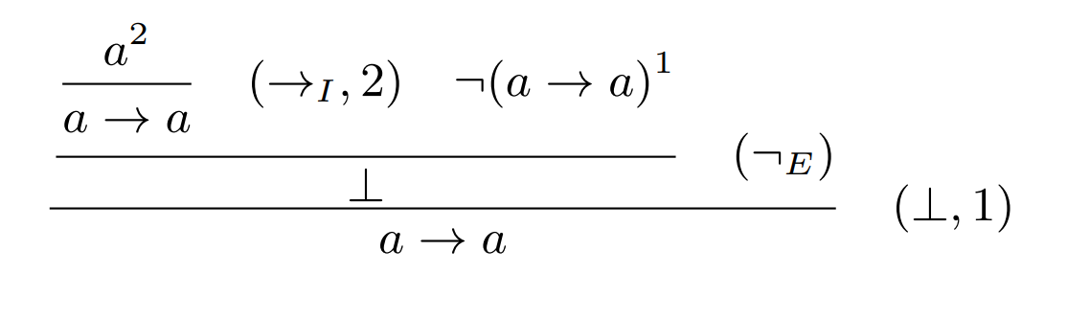





. . .
Incomplete proof
State: {¬a,{¬(a→a)}}
¬
No solution found
. . .
Incomplete proof
State: {¬a,{¬(a→a)}}
¬
No solution found

Slide 11
ε
a→a
ε
a
¬(a→a)
a
a→a
⊥
⊥
a→a
→_{I}
a
b
→_{E}
⊥
¬_{E}
¬(a→a)
ε
a→b
ε
Decomposition ⊢ {}
Final Graph
¬a
ε
¬_{E}
⊥
¬_{E}
ε
¬(a→a)
ε
¬a
¬(a →a)
ε
⊥
→_{I}
⊥
a
a
a→a
→_{E}
ε

Slide 12
⊥
¬(a∨b)
⊥
a∨b
¬¬(a∨b)
a∨b
¬_{I}
⊥
¬_{I}
¬(a∨b)
a
b
¬_{I}
a
⊥
a →a
¬_{I}
¬a
ε
¬_{E}
¬_{E}
ε
¬(a→a)
¬a
¬(a →a)
ε
ε
⊥
⊥
a
→_{I}
a
a→a
→_{E}
ε

Slide 13
Compute Transitions
⊥
⊥
¬(a →a)
¬a
¬(a →a)
⊥
⊥
⊥
a
→_{I}
a
→_{I}
a
a→a
a
a→a
→_{E}
ε
→_{E}
ε
1st Exploring a→a
2nd Exploring a
¬_{I}
a
⊥
¬_{I}
a
⊥
a →a
¬_{I}
¬a
ε
¬_{E}
¬a
ε
¬_{E}
¬_{E}
ε
¬(a→a)
¬a
¬(a →a)
¬a
¬(a →a)
ε
ε
ε
⊥
⊥
⊥
⊥
a
→_{I}
a
→_{I}
a
a→a
a
a→a
→_{E}
ε
→_{E}
ε
3rd Exploring ¬a
4th Exploring ¬(a→a)

Slide 14

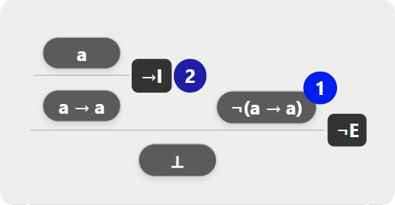
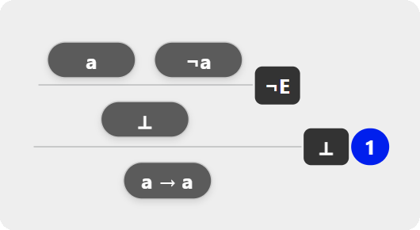
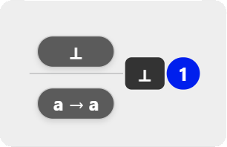
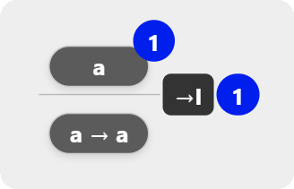
Compute Transitions
a
¬_{I}
a
⊥
a →a
⊥
⊥
¬_{I}
⊥
¬_{I}
¬a
ε
¬_{E}
¬a
ε
¬_{E}
¬_{E}
ε
¬(a→a)
¬(a →a)
¬a
¬(a →a)
¬a
¬(a →a)
¬a
¬(a →a)
ε
ε
ε
⊥
⊥
⊥
⊥
⊥
⊥
⊥
a
→_{I}
a
→_{I}
a
→_{I}
a
→_{I}
a
a→a
a
a→a
a
a→a
a
a→a
→_{E}
ε
→_{E}
ε
→_{E}
ε
→_{E}
ε
1st Exploring a→a
2nd Exploring a
3rd Exploring ¬a
4th Exploring ¬(a→a)

Slide 15
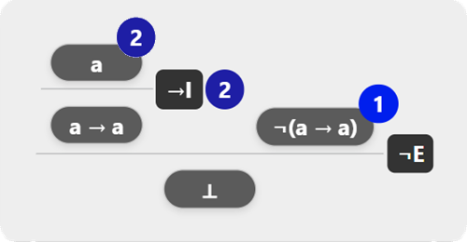
Incomplete proof
Possible solution
Feedback
Try to apply the Elimination of Negation rule
Goal: {¬(a→a)}⊢ ⊥
You are two steps away
Incomplete proof
Feedback
Goal: {¬(a→a)}⊢ ⊥
Invalid goal
The proof may be too complex
Valid goal
Go back 1 step

Slide 16
Transition Graph Construction
⊥
¬_{I}
a
⊥
⊥
¬a
ε
¬_{E}
¬(a →a)
¬a
¬(a →a)
¬a
¬(a →a)
ε
⊥
⊥
⊥
⊥
⊥
a
→_{I}
a
→_{I}
a
→_{I}
a
a→a
a
a→a
a
a→a
→_{E}
ε
→_{E}
ε
→_{E}
ε
1st Exploring a→a
2nd Exploring a
3rd Exploring ¬a
¬_{I}
a
⊥
a →a
¬_{I}
¬a
ε
¬_{E}
¬_{E}
ε
¬(a→a)
¬a
¬(a →a)
ε
ε
⊥
⊥
a
→_{I}
a
a→a
→_{E}
ε
4th Exploring ¬(a→a)

Slide 17
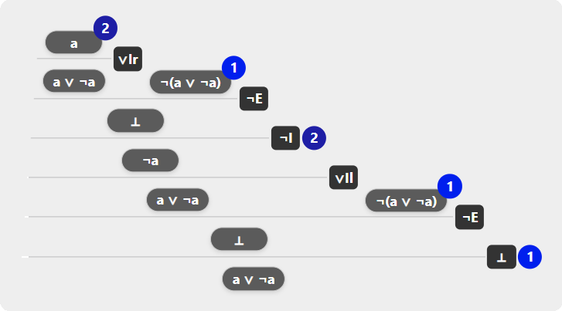
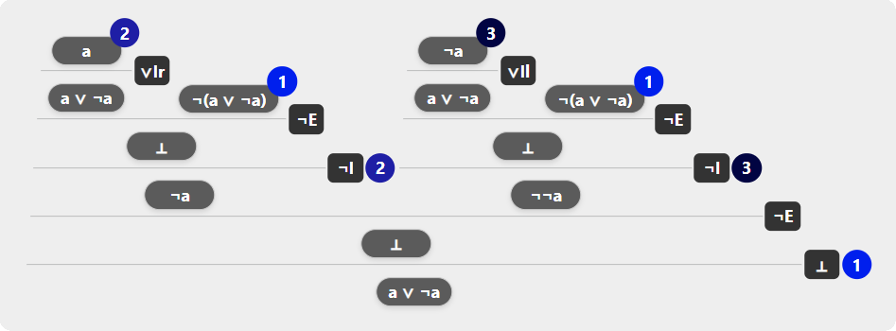
Height: 6 Size: 12
Height: 7 Size: 9

